Slide 1

SMART GRADER
SPRING 2022 CAPSTONE PROJECT | DELIVERABLE-8
GUIDED BY-PROF.HENRY WONG

Slide 2

TEAM MEMBERS | ROLE
AKANKSHYA BISWAL | Technical Writer & QA Tester
EMI HARRY | Front-end Developer & UI Designer
GIO ABOU JAOUDE | ML Developer & Technical Writer
JONATHAN ANGAMARCA | QA Tester
JOSEPH DOUGAL | Full-stack Developer & Tech Writer
JOSE SALCEDO | Technical Writer & QA Tester
RITHVIK SUBRAMANYA | QA Tester
TJ RABBANI |Front-end Developer

Slide 3

AGENDA
Project Description
Design Architecture
Sprint 1 Recap
Sprint-2 Recap
Sprint-3 Recap
Sprint-4 Recap
Sprint-5 Recap
Sprint-6 Recap
Sprint-7 Recap
Sprint-8
Product Backlog
Burndown Chart(Sprint-8)
Retrospective
Conclusion
Project Demo
Notes:
Project Description and Project Components
Technologies used in the project
Market Analysis
User personas
Milestone timeline
Retrospective: things that worked

Slide 4

PROJECT DESCRIPTION

Slide 5
WHAT IS SMART GRADER?
A website that can generate and grade answers to math and essay-based assignments.
HOW DOES SMART GRADER WORKS?
Allows different types of accounts-Students, Educator.
Educators can generate questions for students with built-in math generator.
NLP is used to generate and score text-based questions and answers.
Checks correlation for text responses between a student answer and a teacher answer to grade that answer.
WHY DO YOU WANT SMART GARDER?
Lack of sufficient study time.
Lack of automated English grading platforms.
A need for a variety of questions.
Smart way to grade assignment.

Slide 6

PERSONA 1-COLLEGE STUDENT
Name : Monica
Age : 19 – 21 years old
Status : Grad student
Problem : No time to study due to work.
Solution : Signs up for Smart Grader. Gets all the assignments in an organized manner.

Slide 7

PERSONA 2-SCHOOL TEACHER
Name : Jack
Age : 34 – 36 years old
Status : High School History Teacher
Problem : Has too many papers to grade.
Solution : Signs up for Smart Grader. Inputs question and relevant text. Smart Grader does the rest.

Slide 8
SMART GRADER REQUIREMENT
Login to the application.
Teachers/educators can generate & post questions for assignments .
Students can solve the assignments posted by their teachers and submit the assignments.
Smart Grader would automatically grade the assignments.
Grades would be available for both Math and English based assignment questions.

Slide 9

DESIGN ARCHITECTURE

Slide 10




TECHNOLOGIES USED
TensorFlow
AWS (Amazon Web Services)
Python
Bootstrap

Slide 11

FRONT-END DESIGN

Slide 12
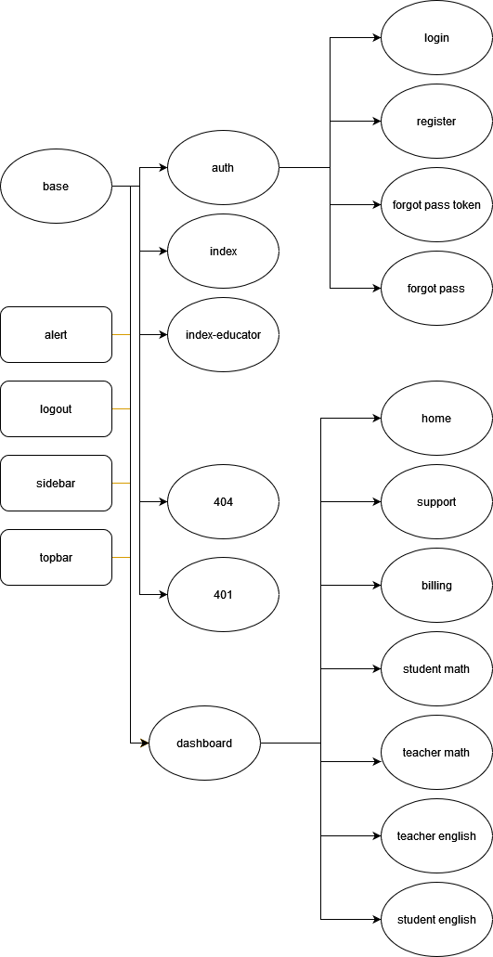
Fig. 1. Front End Diagram

Slide 13
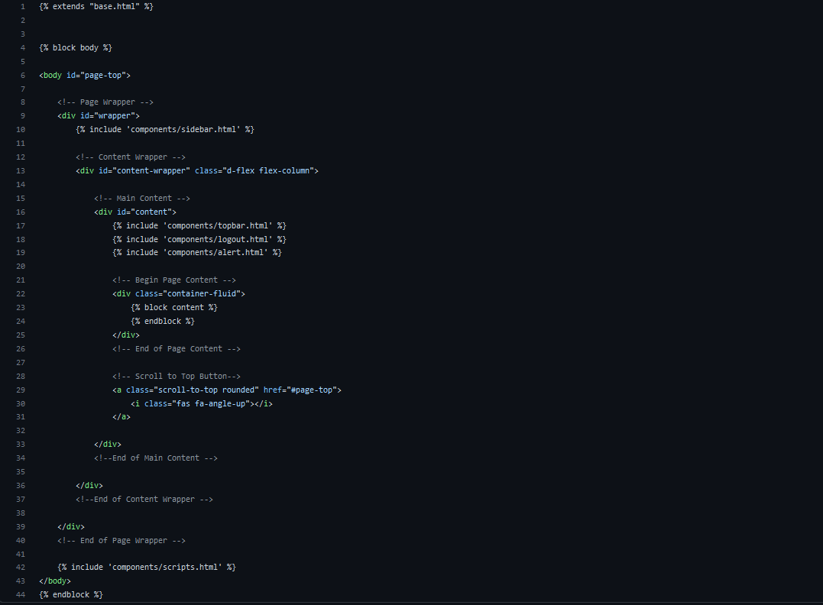
Jinja2 Templating

Slide 14

BACK-END DESIGN

Slide 15
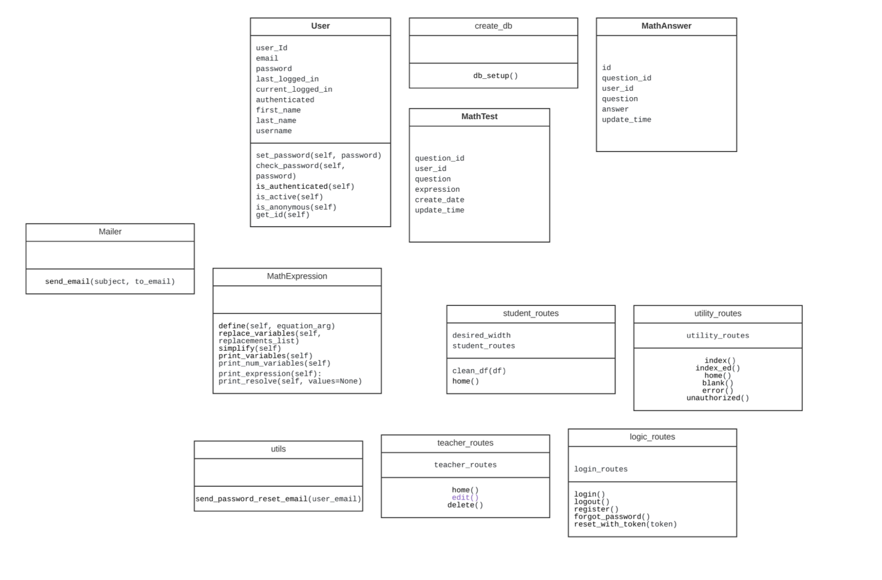
UML CLASS DIAGRAM

Slide 16
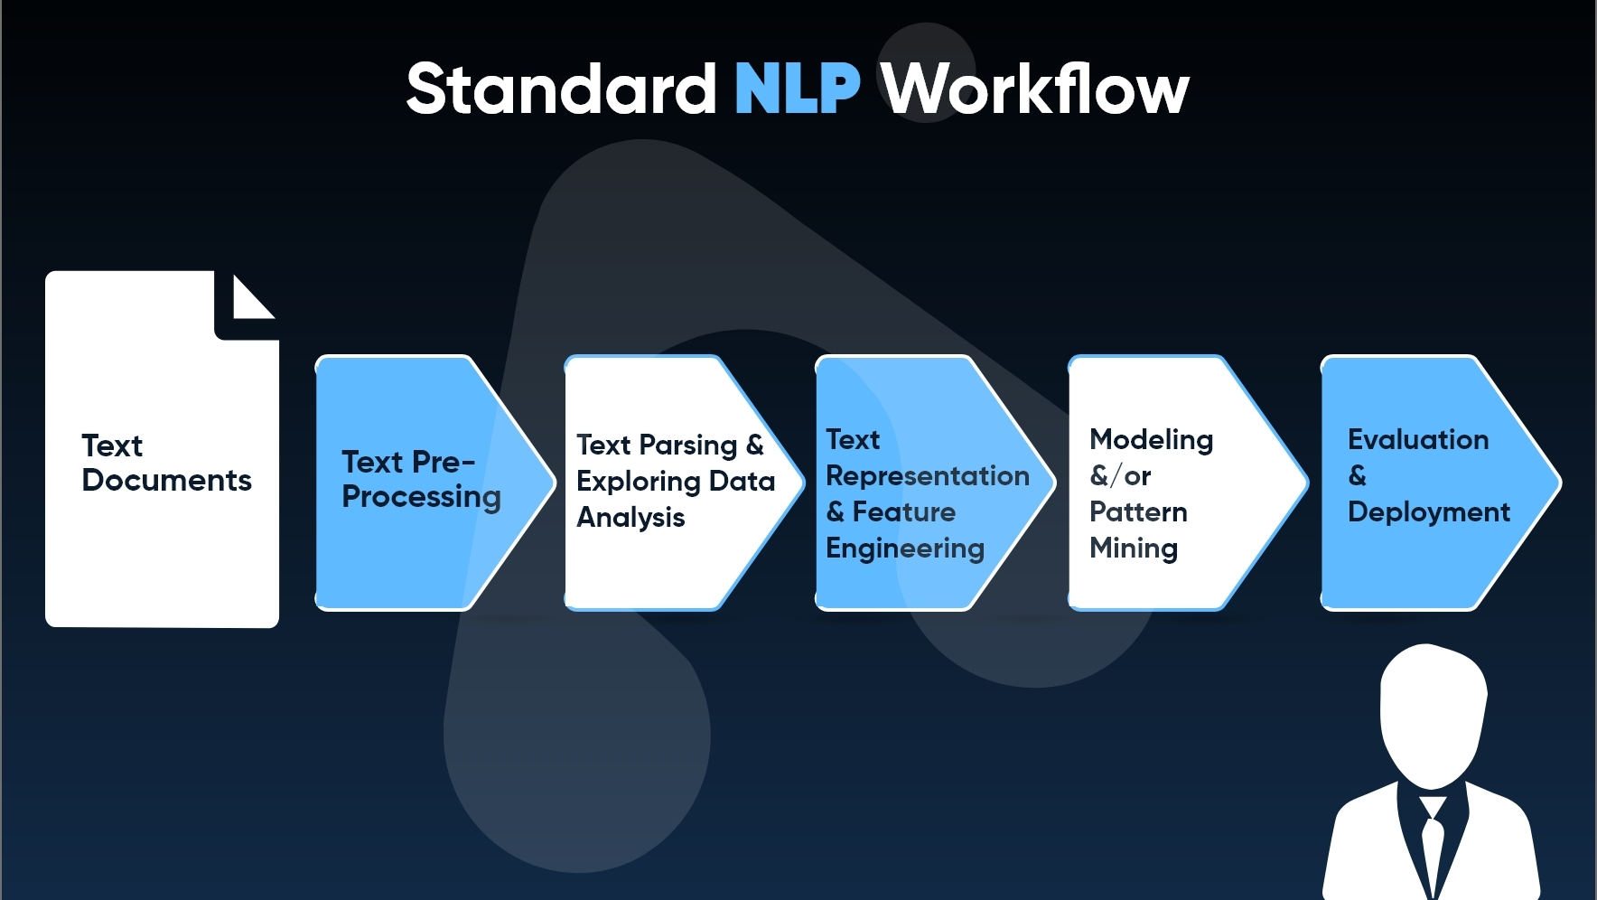

Slide 17
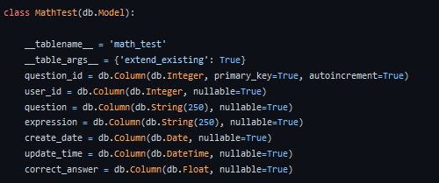
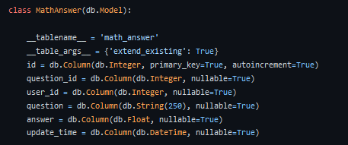
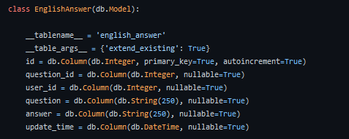
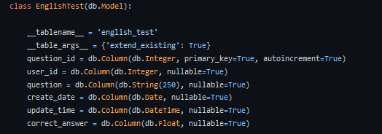
DB Models

Slide 18

SPRINT RECAP 1-7

Slide 19

SPRINT-1 RECAP

Slide 20
Committed Task/Stories for Sprint-1
​​ Task/Story​​ | Key​​ | Description | Story/Task Points​​ | ​​ Priority​​ | Status
Task | Key-1 | Create significant business application idea . | 5 | Highest | Done
Task | Key-2 | Project Survey | 3 | High | Done
Task | Key-3 | Establish team dynamics. | 3 | High | Done
Task | Key-4 | Setup development tools & shared drive access. | 2 | High | Done
Task | Key-5 | Working on user personas. | 3 | High | Done
Task | Key-6 | Understanding the project deliverable requirements. | 1 | Medium | Done

Slide 21
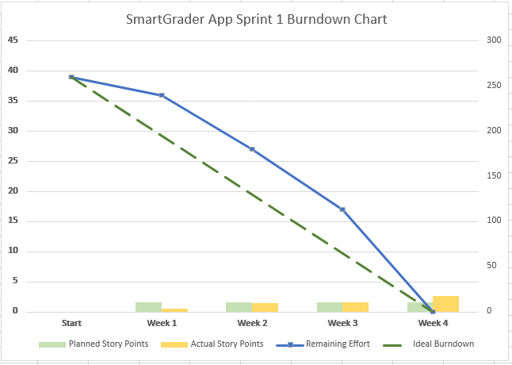
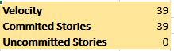
SPRINT-1 BURNDOWN CHART

Slide 22

SPRINT-2 RECAP

Slide 23
Completed Task/Stories for Sprint-2
​​ Task/Story​​ | Key​​ | Description | Story/Task Points​​ | ​​ Priority​​ | Status
Task | Key-7 | Create mock-up web design. | 5 | Highest | Done
Task | Key-8 | Completed the Front-End of the application. | 3 | High | Done
Story | Key-1 | As a Student, I should be able to access the link to Smart Grader so that I can create a student account. |  | High | Done
Story | Key-2 | As an Educator, I should be able to access the link to Smart Grader so that I can create an Educator account. |  | High | Done
Task | Key-11 | Complete Test Cases and user stories. | 3 | High | Done
Task | Key-12 | Create the sprint backlog and product backlog. | 3 | Medium | Done
Task | Key-12 | Schedule weekly team meetings. | 1 | Medium | Done

Slide 24
SPRINT BACKLOG(SPRINT-2)
​​ Task/Story​​ | Key​​ | Description | Story/Task Points​​ | ​​ Priority​​ | Status
Task | Key-13 | Start the backend(ML) for the application. | 5 | Highest | In Progress
Task | Key-14 | Add features to the Front-End of the application. | 3 | High | In Progress
Task | Key-15 | Create the wiki page for Smart Grader. | 1 | Medium | In Progress
Task | Key-16 | Complete the technical paper for Smart Grader. | 3 | High | In Progress

Slide 25
TEST CASES FOR | ID | TEST CASES | EXPECTED RESULTS | Actual Result | Pass/Fail
Homepage (Test ID-1) | Key-1 | Browse the Website | Different types of users should be able to access the homepage of the website. | Once the user access the link, they will be directed to Smart Grader homepage. | Pass
Homepage (Test ID-2) | Key-1 | Create account on the Website | Users should be able to create accounts on the website to successfully log in to the website. | Once the users are in Smart Grader homepage, they can create their account. | Pass
TEST CASES FOR SPRINT-2

Slide 26
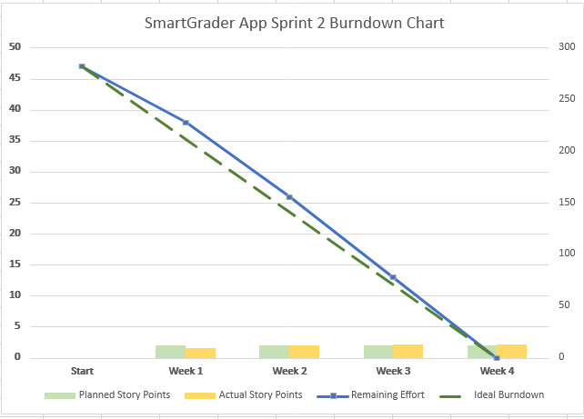
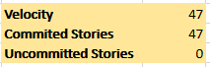
SPRINT-2 BURNDOWN CHART

Slide 27

SPRINT-3 RECAP
This Photo by Unknown author is licensed under CC BY.

Slide 28
Completed Task/Stories for Sprint-3
​​ Task/Story​​ | Key​​ | Description | Story/Task Points​​ | ​​ Priority​​ | Status
Task | Key-13 | Write/Review code for backend(ML) for Smart Grader. | 5 | Highest | Done
Task | Key-14 | Add features to the Front-End of the application. | 3 | High | Done
Task | Key-15 | Create the wiki page for Smart Grader. | 1 | Medium | Done
Task | Key-16 | Complete the technical paper for Smart Grader. | 3 | High | Done
Story | Key-3 | As a user, I should be able to use the 'Forget password' option so that I can reset my password in case I forget my login password. |  | High | Done

Slide 29
SPRINT BACKLOG(SPRINT-3)
​​ Task/Story​​ | Key​​ | Description | Story/Task Points​​ | ​​ Priority​​ | Status
Task | Key-17 | Complete our code base for the math-based questions(ML backend). | 8 | Highest | In Progress
Task | Key-18 | Integration of ML and the UI. | 5 | High | In Progress
Task | Key-19 | Create two user groups-Student and Educator to provide different level of access for both. | 5 | High | In Progress
Task | Key-20 | Modify the front-end of Educator account to enable generate/delete/submit option for math questions. | 5 | High | In Progress
Task | Key-21 | Modify the student account to enable 'load test' and 'update' button. | 5 | High | In Progress

Slide 30
TEST CASES FOR | ID | TEST CASES | EXPECTED RESULTS | Actual Result | Pass/Fail
Homepage (Test ID-3) | Key-3 | Forgot Password | Existing users should be able to reset their password using 'forgot password' option on the homepage of the website. | Users can reset their password once they reach the homepage of Smart Grader using 'forgot password' option. | Pass
TEST CASES FOR SPRINT-3

Slide 31
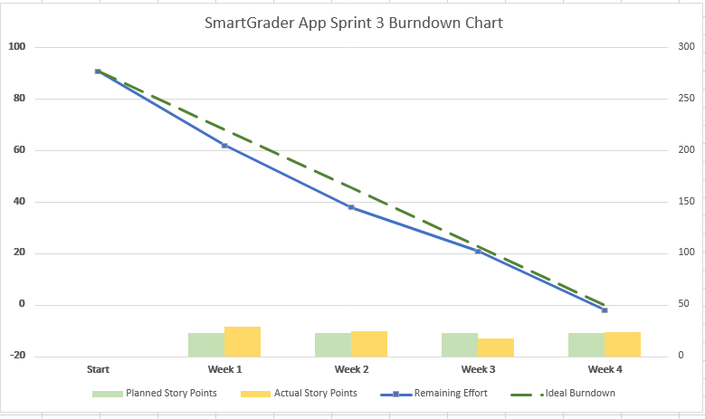
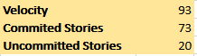
SPRINT-3 BURNDOWN CHART

Slide 32

SPRINT-4 RECAP
This Photo by Unknown author is licensed under CC BY-NC.

Slide 33
Completed Task/Stories for Sprint-4
​​ Task/Story​​ | Key​​ | Description | Story/Task Points​​ | ​​ Priority​​ | Status
Task | Key-17 | Complete our code base for the math-based questions(ML backend). | 8 | Highest | Done
Task | Key-18 | Integration of ML and the UI. | 5 | High | Done
Task | Key-19 | Create two user groups-Student and Educator to provide different level of access for both. | 5 | High | Done
Task | Key-20 | Modify the front-end of Educator account to enable generate/delete/submit option for math questions. | 5 | High | Done
Story | Key-4 | As an Educator, I want to check the subject's tab so that I can give Math's assignments. |  | High | Done
Story | Key-5 | As an Educator, I want to use the "Insert" button to insert Math questions for the assignment. |  | High | Done

Slide 34
Completed Task/Stories for Sprint-4
​​ Task/Story​​ | Key​​ | Description | Story/Task Points​​ | ​​ Priority​​ | Status
Story | Key-6 | As an Educator, I want a "Delete" option so that I can remove previously posted questions from assignments when I feel they are old or wrong. |  | High | Done
Story | Key-7 | As an Educator, I want to have the option of adding questions so that I can have unique assignment questions for my students. |  | High | Done
Task | Key-21 | Modify the student account to enable 'load test' and 'update' button. | 5 | High | Done
Story | Key-8 | As a Student, I want to be able to view the latest test so that I can do all my assignments in time. |  | High | Done
Story | Key-9 | As a Student, I want to use the 'Update' button to update my answers for the math questions. |  | High | Done

Slide 35
SPRINT BACKLOG(SPRINT-4)
​​ Task/Story​​ | Key​​ | Description | Story/Task Points​​ | ​​ Priority​​ | Status
Task | Key-22 | Modify login page for users with more advanced features(including all the information regarding Smart Grader on the login page). | 3 | High | In Progress
Task | Key-23 | Modify the user input page to enable users to scroll down the subject's tab. | 5 | Highest | In Progress
Task | Key-24 | Modify the user homepage to enable user to logout from Smart Grader application without any issue. | 3 | High | In Progress
Task | Key-25 | Work on the back-end code for English(text based) assignment grading. | 3 | High | In Progress
Task | Key-26 | Update the wiki page and create milestone timelines for upcoming sprints. | 1 | Low | In Progress

Slide 36
TEST CASES FOR | ID | TEST CASES | EXPECTED RESULTS | Actual Result | Pass/Fail
User Input Page (Test ID-4) | Key-5 | Generate questions for math. | Teachers should be able to input math questions for the assignment. | After a teacher/educator login to smart Grader they will be able to input math questions using "Insert question," button. | Pass
User Input Page (Test ID-5) | Key-6 | Delete questions | Teachers should be able to delete any questions from the assignment. | After teacher/educator login to smart Grader they will be able to delete any questions using 'delete question' button. | Pass
User Input Page (Test ID-6) | Key-6 | Locate the upload file button | Teachers should locate the upload file button to upload the textbook pdf or notes to upload. | This feature will be available by next semester. | Fail
TEST CASES FOR SPRINT-4

Slide 37
TEST CASES FOR | ID | TEST CASES | EXPECTED RESULTS | Actual Result | Pass/Fail
User Input Page (Test ID-7) | Key-7 | Submit the questions | Teachers should find the submit button to finally upload the file | A Teacher/educator should be able to update the questions using 'Update' button. | Pass
User Input Page (Test ID-8) | Key-8 | Load Test | Students should be able to find the 'load test' button on the page. | After a student logs in to smart Grader, they will be able to find 'load test' button on the page. | Pass
User Input Page (Test ID-9) | Key-9 | Update | Students should be able to update their answers. | A student should be able to update the answers using 'Update' button. | Pass
User Input Page (Test ID-10) | Key-4 | Displaying Subject | Every user would be able to locate a button which will display all the subjects for which they can get/create assignments. | After the user login to the application every user would be able to locate 'subject' dropdown on the left-hand side of their page. | Pass

Slide 38
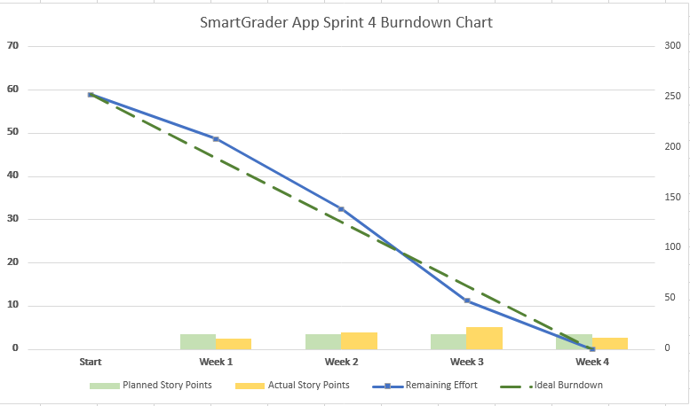
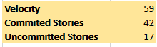
SPRINT-4 BURNDOWN CHART

Slide 39

SPRINT-5 RECAP
This Photo by Unknown author is licensed under CC BY-NC.

Slide 40
Completed Task/Stories for Sprint-5
​​ Task/Story​​ | Key​​ | Description | Story/Task Points​​ | ​​ Priority​​ | Status
Task | Key-22 | Modify login page for users with more advanced features(including all the information regarding Smart Grader on the login page). | 3 | High | Done
Story | Key-10 | As an educator, I want to know the update on the new features that are added to the Smart Grader application so that I can use them. |  | High | Done
Task | Key-23 | Modify the user input page to enable users to scroll down the subject's tab. | 5 | Highest | Done
Story | Key-11 | As an educator, I want to access the 'Subject Tab' so that I can get a list of all the subjects for which I would be able to create assignments for the students.

Slide 41
Completed Task/Stories for Sprint-5
​​ Task/Story​​ | Key​​ | Description | Story/Task Points​​ | ​​ Priority​​ | Status
Task | Key-24 | Modify the user homepage to enable user to logout from Smart Grader application without any issue. | 3 | High | Done
Story | Key-12 | As a student, I want to logout from the application after successfully submitting my homework but was unable to logout. |  | High | Done
Task | Key-25 | Work on the back-end code for English(text based) assignment grading. | 3 | High | Done
Task | Key-26 | Update the wiki page and create milestone timelines for upcoming sprints. | 1 | Low | Done

Slide 42
SPRINT BACKLOG(SPRINT-5)
​​ Task/Story​​ | Key​​ | Description | Story/Task Points​​ | ​​ Priority​​ | Status
Task | Key-27 | Built the teacher-english html. | 8 | Highest | In Progress
Task | Key-28 | Setup database tables for teacher and student. | 5 | High | In Progress
Task | Key-29 | Built backend functionality to insert questions. | 3 | High | In Progress
Task | Key-30 | Built backend functionality to update questions. | 3 | High | In Progress
Task | Key-31 | Built backend functionality to delete questions. | 3 | High | In Progress
Task | Key-32 | View text that will be used in ML process to check students answers to teacher's questions. | 2 | Medium | In Progress

Slide 43
TEST CASES FOR​ | KEY | TEST CASES​ | TEST DATA | EXPECTED RESULTS​ | ACTUAL RESULT | Pass/Fail​
Homepage​ (Test ID-11) | Key-12 | Logout button | Users could not log out of their accounts. | Every user should be able to log out of the application. | Every user would be able to find the logout option in the top right-hand side of the page . | Pass​
​Login Page (Test ID-12) | Key-11 | Feature button | New feature updates would be visible. | Every user should get an update of the new features that have been added to the Smart Grader. | Every user would be able to find the feature button on the top of the login page. | Pass​
TEST CASE FOR SPRINT-5

Slide 44
TEST CASES FOR​ | KEY | TEST CASES​ | TEST DATA | EXPECTED RESULTS​ | ACTUAL RESULT | Pass/Fail​
​Homepage (Test ID-13) | Key-11 | Subject button | Displaying Subject | Every user would be able to locate a button which will display all the subjects for which they can get/create assignments. | After the user login to the application every user would be able to locate 'subject' dropdown on the left-hand side of their page. | Pass​
TEST CASE FOR SPRINT-5

Slide 45
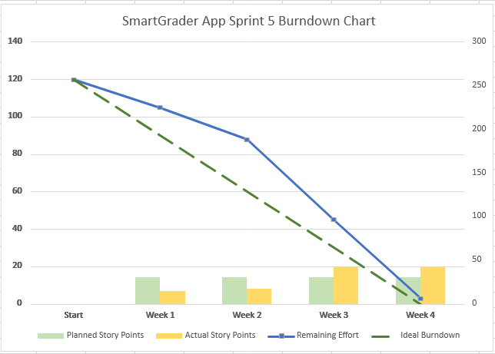
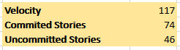
SPRINT-5 BURNDOWN CHART

Slide 46

SPRINT-6 RECAP

Slide 47
Completed Task/Stories for Sprint-6
​​ Task/Story​​ | Key​​ | Description | Story/Task Points​​ | ​​ Priority​​ | Status
Task | Key-27 | Built the teacher-english html. | 8 | Highest | Done
Story | Key-13 | As an educator, I want to access the 'English' tab from Subject's menu so that I can set up English questions for the assignment. |  | High | Done
Task | Key-28 | Setup database tables for teacher and student. | 5 | High | In Progress
Task | Key-29 | Built backend functionality to insert questions. | 3 | High | In Progress
Task | Key-30 | Built backend functionality to update questions. | 3 | High | In Progress
Task | Key-31 | Built backend functionality to delete questions. | 3 | High | In Progress

Slide 48
Completed Task/Stories for Sprint-5
​​ Task/Story​​ | Key​​ | Description | Story/Task Points​​ | ​​ Priority​​ | Status
Story | Key-14 | As an educator, I want use the 'insert' button to insert the English questions for the assignment. |  | High | Done
Story | Key-15 | As an educator, I want to use the 'delete' button to delete the English questions for the assignment. |  | High | Done
Story | Key-16 | As an educator, I want to use the 'Show text' button to see the text for which I would be able to create the English questions for the assignment. |  | High | Done
Task | Key-32 | View text that will be used in ML process to check students answers to teacher's questions. | 2 | Medium | Done
Task | Key-33 | Deploy ML code for testing and integration | 2 | Medium | Done

Slide 49
SPRINT BACKLOG(SPRINT-6)
​​ Task/Story​​ | Key​​ | Description | Story/Task Points​​ | ​​ Priority​​ | Status
Task | Key-34 | Built student-English html. | 8 | Highest | In Progress
Task | Key-35 | Adding student English routes for the student account. | 5 | High | In Progress
Task | Key-36 | Built backend functionality to insert answer for student account. | 5 | High | In Progress
Task | Key-37 | Built backend functionality to update answer for student account. | 5 | High | In Progress
Task | Key-38 | Setting up an NLP pipeline to compare and grade users answers with ML generated results. | 3 | Medium | In Progress

Slide 50
TEST CASES ​ FOR​​ | KEY​ | TEST CASES​​ | TEST DATA​ | EXPECTED RESULTS​​ | ACTUAL RESULT​ | Pass/Fail​​
Input Page (Test ID-14) | Key-13 | Subject button | Users in the educator account should be able to navigate to the English tab in the subject's menu. | Every user in the educator profile should be able to access the English subject tab. | Educators can now navigate to the English tab in the subject's menu. | Pass​​
​Input page (Test ID-15) | Key-14 | Insert button | Users in the educator account should be able to insert English questions for the assignment. | Every user in the educator profile should be able to create English questions. | Educators can now create English questions for the assignments using "insert question" button. | Pass​​
TEST CASE FOR SPRINT-6

Slide 51
TEST CASES ​​FOR​​​ | KEY​​ | TEST CASES​​​ | TEST DATA​​ | EXPECTED RESULTS​​​ | ACTUAL RESULT​​ | Pass/Fail​​​
Input Page​ (Test ID-16) | Key-15 | Delete button | Users in the educator account should be able to delete English questions for the assignment. | Every user in the educator profile should be able to delete English questions. | Educators can now create English questions for the assignments using "delete question" button. | Pass​​​
​Input page​ (Test ID-17) | Key-16 | Show text button | Users in the educator account should be able to see the text for which they would be able to create English questions for the assignment.​ | Every user in the educator profile should be able to see the text to create English questions.​ ​ | Educators can now see the text in which they would create English questions using "show text" button. | Pass​​​
TEST CASE FOR SPRINT-6

Slide 52
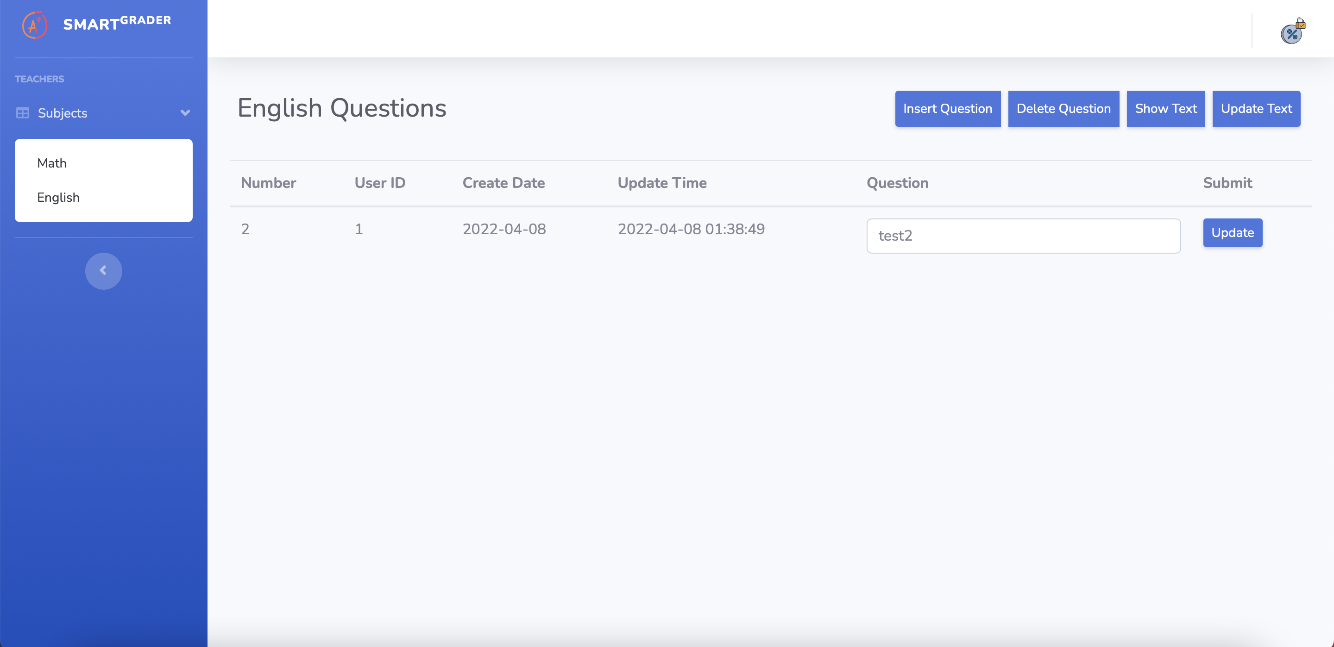
Changes Made on Smart Grader for SPRINT-6

Slide 53
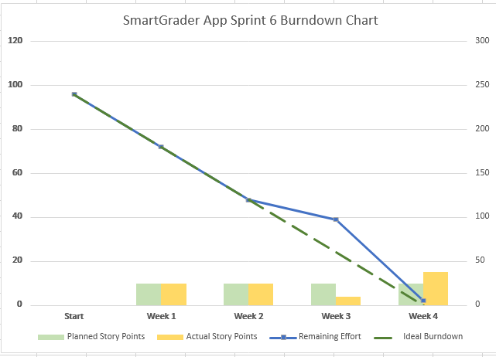

SPRINT-6 BURNDOWN CHART

Slide 54

SPRINT-7 RECAP

Slide 55
Completed Task/Stories for Sprint-7
​​ Task/Story​​ | Key​​ | Description | Story/Task Points​​ | ​​ Priority​​ | Status
Task | Key-34 | Built student-English html. | 8 | Highest | Done
Task | Key-35 | Adding student English routes for the student account. | 5 | High | Done
Story | Key-17 | As a Student, I want to navigate to the English section in the Menu Tab so that I can access the English assignment questions. |  | High | Done
Task | Key-36 | Built backend functionality to insert answer for student account. | 5 | High | Done
Story | Key-18 | As a Student, I want to access the 'insert' button to insert answer to the English questions in the assignment. |  | High | Done

Slide 56
Completed Task/Stories for Sprint-7
​​ Task/Story​​ | Key​​ | Description | Story/Task Points​​ | ​​ Priority​​ | Status
Task | Key-37 | Built backend functionality to update answer for student account. | 5 | High | Done
Story | Key-19 | As a Student, I want to access the 'update' button to update answers in the English assignment. |  | High | Done
Task | Key-38 | Work on the technical paper and burndown charts. | 3 | Low | Done

Slide 57
SPRINT BACKLOG(SPRINT-7)
​​ Task/Story​​ | Key​​ | Description | Story/Task Points​​ | ​​ Priority​​ | Status
Task | Key-39 | Display Math and English Test Result | 8 | Highest | In Progress
Task | Key-40 | Setting up an NLP pipeline to compare and grade users answers with ML generated results. | 5 | High | In Progress
Task | Key-41 | Work on the front-end design of Smart Grader. | 3 | High | In Progress
Task | Key-42 | Update the wiki page. | 1 | Medium | In Progress
Task | Key-43 | Work on the technical paper of Smart Grader. | 1 | Medium | In Progress

Slide 58
TEST CASES ​ FOR​​ | KEY​ | TEST CASES​​ | TEST DATA​ | EXPECTED RESULTS​​ | ACTUAL RESULT​ | Pass/Fail​​
Input Page (Test ID-18) | Key-17 | Subject button | Users in the student account should be able to navigate to the English tab in the subject's menu. | Every user in the student profile should be able to access the English subject tab. | Students can now navigate to the English tab in the subject's menu. | Pass​​
​Input page (Test ID-19) | Key-18 | Answer Field | Users in the student account should be able to insert the English answers for the assignment. | Every user in the student profile should be able to insert answer to the English questions. | Students can now insert answer to the English questions in the answer field. | Pass​​
TEST CASE FOR SPRINT-7

Slide 59
TEST CASES ​ FOR​​ | KEY​ | TEST CASES​​ | TEST DATA​ | EXPECTED RESULTS​​ | ACTUAL RESULT​ | Pass/Fail​​
Input Page (Test ID-20) | Key-19 | Update button | Users in the student account should be able to update the English answer for the assignment. | Every user in the student profile should be able to update the English answer. | Students can now update the wrong answers that they have inserted by using the "Update" button. | Pass​​
TEST CASE FOR SPRINT-6

Slide 60
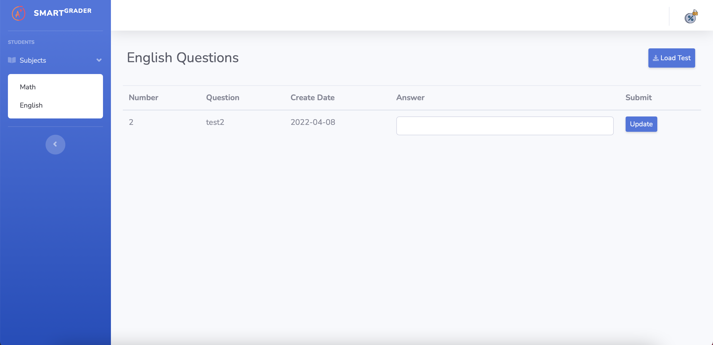
Changes Made on Smart Grader for SPRINT-7

Slide 61
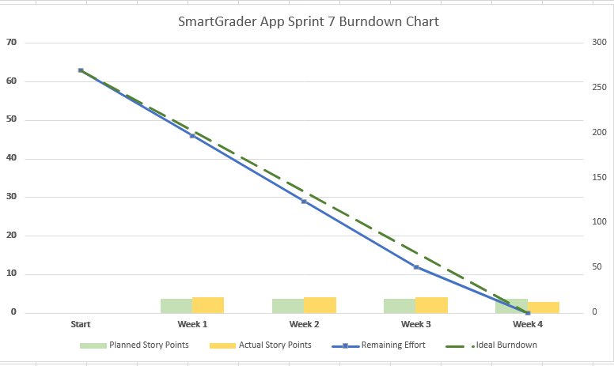
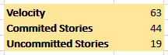
SPRINT-7 BURNDOWN CHART

Slide 62

SPRINT-8
This Photo by Unknown author is licensed under CC BY-ND.

Slide 63
Completed Task/Stories for Sprint-8
​​ Task/Story​​ | Key​​ | Description | Story/Task Points​​ | ​​ Priority​​/Status
Task | Key-39 | Display Math and English Test Result | 8 | Highest
Task | Key-40 | Setting up an NLP pipeline to compare and grade users answers with ML generated results. | 5 | High
Task | Key-41 | Work on the front-end of Smart Grader. | 3 | High
Story | Key-20 | As an educator, I should be able to access 'Generate Report' button to download the grades of the student for the assignment I have provides for Math. |  | High
Story | Key-21 | As an educator, I should be able to access 'Generate Report' button to download the grades of the student for the assignment I have provides for English. |  | High

Slide 64
Completed Task/Stories for Sprint-8
​​ Task/Story​​ | Key​​ | Description | Story/Task Points​​ | ​​ Priority​​/Status
Story | Key-22 | As an Educator, I should be able to access 'View Summary' button to see the test results for Math/English assignments. |  | Highest
Task | Key-42 | Update wiki page. | 1 | Medium
Task | Key-43 | Complete Technical paper for Smart Grader. | 1 | Medium

Slide 65

SPRINT-8 TEST CASES

Slide 66
TEST CASES ​ FOR​​ | KEY​ | TEST CASES​​ | TEST DATA​ | EXPECTED RESULTS​​ | ACTUAL RESULT​ | Pass/Fail​​
Home Page (Test ID-21) | Key-41 | 'View Summary' Tab | Users in the student account should be able to access 'view summary' tab to check their grades. | Every user in the student profile should be able to check their grades. | Students can now navigate to the 'view summary' tab to check their grades. | Pass​​
​Home page (Test ID-22) | Key-39 | 'Check your Math Assignment' Tab | Users in the student account should be able to access 'Check your Math Assignment' tab to check their Math's Assignments. | Every user in the student profile should be able to view their Math's assignment. | Students can now navigate to the 'Check your Math Assignment' tab to check their Math assignment. | Pass​​

Slide 67
TEST CASES ​ FOR​​ | KEY​ | TEST CASES​​ | TEST DATA​ | EXPECTED RESULTS​​ | ACTUAL RESULT​ | Pass/Fail​​
Input Page (Test ID-23) | Key-39 | 'Check Your English Assignment' Tab | Users in the student account should be able to access 'Check your English Assignment' tab to check their English's Assignments. | Every user in the student profile should be able to view their English assignment. | Students can now navigate to the 'Check your English Assignment' tab to check their English assignment. | Pass​​
Input Page (Test ID-24) | Key-41 | 'View Summary' Tab | Users in the Educator account should be able to access 'view summary' tab to check the student grades. | Every user in the Educator profile should be able to view the student grades. | Educators can now navigate to the 'View Summary' tab to check the student grades. | Pass

Slide 68
TEST CASES ​ FOR​​ | KEY​ | TEST CASES​​ | TEST DATA​ | EXPECTED RESULTS​​ | ACTUAL RESULT​ | Pass/Fail​​
Input Page (Test ID-25) | Key-41 | 'Add Math Question' Tab | Users in the Educator account should be able to access 'Add Math Question' tab to add Math questions or set Math assignment. | Every user in the Educator profile should be able to set Math assignment. | Educator can now navigate to the 'Add Math Question' tab to add Math questions or set Math assignment. | Pass​​
Input Page (Test ID-26) | Key-41 | 'Upload new Text' Tab | Users in the Educator account should be able to access 'Upload new Text' tab to add Text based questions or set English assignment. | Every user in the Educator profile should be able to set English assignment. | Educator can now navigate to the 'Upload new Text' tab to add Text based questions or set English assignment. | Pass

Slide 69
PRODUCT BACKLOG
​​ Task/Story​​ | Description | ​​ Priority​​/Status
Task | Enabling Paywall feature for Smart Grader | In Progress
Task | Enabling the Support Feature in Smart Grader | In Progress
Task | This application could be useful for more user personas like-working parent/Head of any organization. | In Progress

Slide 70

SPRINT-8 BURNDOWN CHART

Slide 71
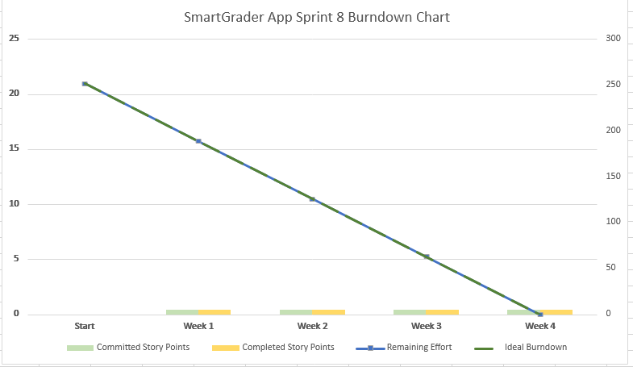
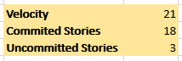
SPRINT-8 BURNDOWN CHART

Slide 72
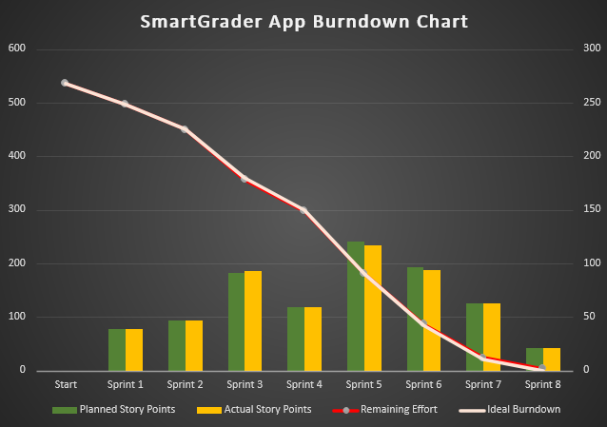
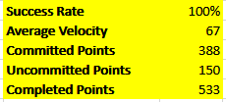
PRODUCT BURNDOWN CHART

Slide 73

GITHUB WIKI PAGE
https://github.com/joseph-dougal/CS691/wiki

Slide 74

RETROSPECTIVE

Slide 75
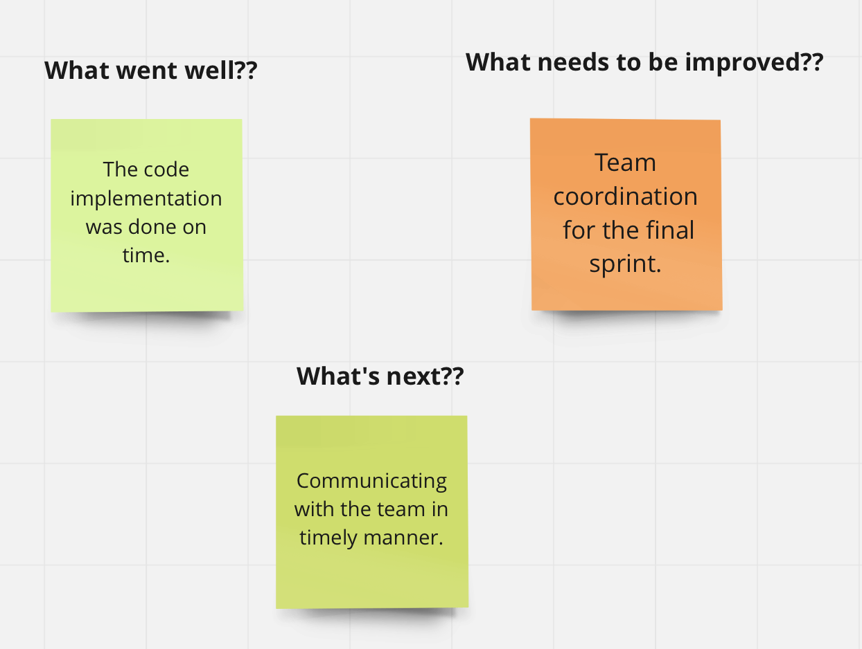

Slide 76

CONCLUSION
FOR MORE DETAILS ON SMART GRADER VISIT OUR GITHUB REPOSITORY:
https://github.com/josephdougal/CS691/projects/1

Slide 77

PROJECT DEMO

